Slide 1

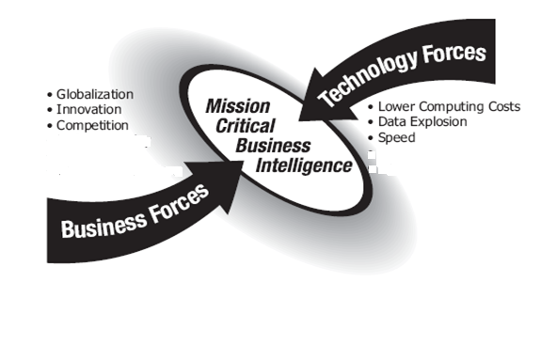

Slide 2
Agenda
Business Intelligence Definition
Why BI?
BI Implementation
Data Integration(SSIS)
Data Storage – Data Warehousing
Data Analysis (SSAS)
Data Mining
Data Representation(SSRS)

Slide 3
Definition of Business Intelligence
Business Intelligence(BI)is a broad category of applications and technologies for gathering, storing, analyzing, and providing access to data to help enterprise users make better business decisions.
BI is a method of storing and
presenting key enterprise data so that anyone in
your company can quickly and easily ask
questions of accurate and timely data.

Slide 4

What is Business Intelligence?
The term Business Intelligence (BI) incorporates the concept of deriving and analyzing useful information from the data in an organization.
Business Intelligence (BI) is about getting the right information, to the right decision makers, at the right time.
Help users to understand why business got the particular results that it did
forecast future results.
BI leads to:
  fact-based decision making
  “single version of the truth”
BI includes reporting and analytics.

Slide 5


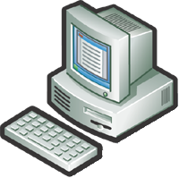





Why BI?
The Five Questions
What happened?
What is happening?
Why did it happen?
What will happen?
What do I want to happen?
Past
Present
Future
Data
ERP
CRM
3Pty

Slide 6
Microsoft BI Growth
Microsoft entered the BI market when it released OLAP Services with SQL Server 7.0. It was a quiet entry until its second BI product release, SQL Server 2000 Analysis Services.
Since its first market entry, Microsoft has taken the approach that BI should not be for the few (business analysts and possibly executives) but for everyone in the organization. This is a key differentiator from the competitor’s BI product suites.
In the first year of release, the market penetration of Microsoft’s 2005 toolset for BI grew at double the average BI toolset rate, approximately 26% as compared to the overall BI market rate of growth, which was around 12%.

Slide 7






Microsoft Business Intelligence
Integrate
Analyze
Report
Data acquisition from source systems and integration
Data transformation
Historical Data with business logic, hierarchical views
Data discovery via data mining
Data presentation and distribution
Data access

Slide 8
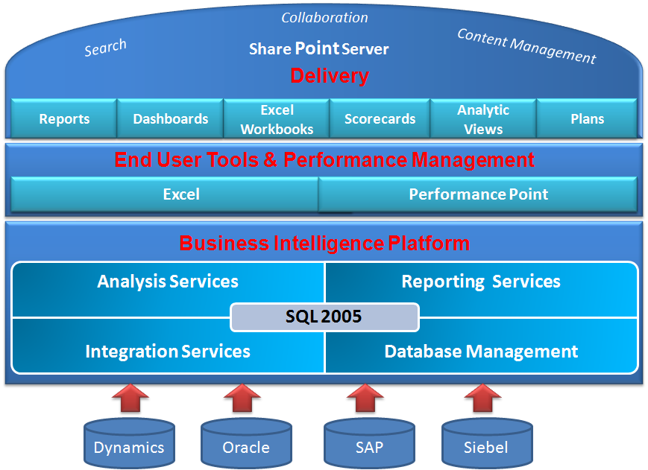
Microsoft BI Platform

Slide 9
Microsoft BI Platform

Slide 10
Implementation of BI
Designing a BI application involves multiple layers
Data Sources
Data Integration
Data Storage
Data Analysis
Data Presentation
Meta data, Security, Performance & Operations

Slide 11
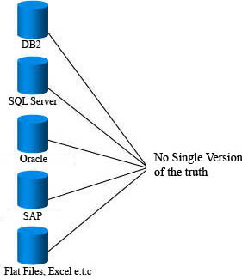
Data Sources
Diverse data sources
Heterogeneous environments
Different database systems
Different schemas, data formats,
Different naming conventions
Geographically separated
source locations
Large Sums of Data (Terabytes)

Slide 12
Implementation of BI
Data Source
Data Integration
Data Storage
Data Analysis
Data Presentation
Meta data, Security, Performance & Operations

Slide 13
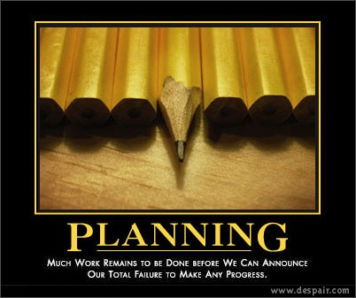
SSIS Planning
After gathering the business requirements, the first step in the design of an ETL component is to plan the data transfer and staging solutions.
This will prevent unnecessary development effort and delayed implementation

Slide 14
Data Integration
Integration is critical for connecting business functionality:
  Data profiling
  Data extraction
  Data staging
  Data transformation
  Data cleansing
  Data loading

Slide 15
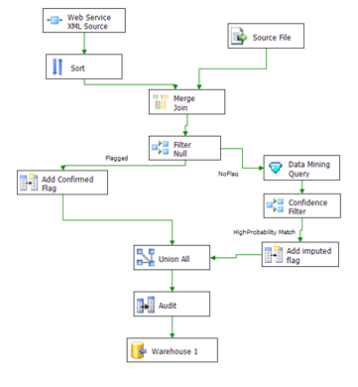
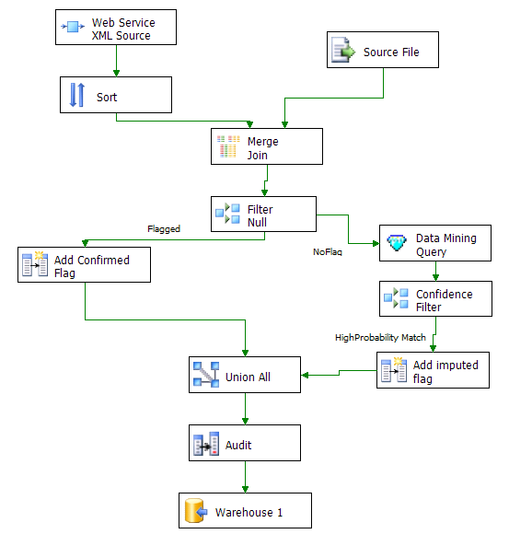
SSIS Example
A new Microsoft SQL Server Business Intelligence application
The platform for a new generation of high performance data integration technologies

Slide 16
Implementation of BI
Data Source
Data Integration
Data Storage
Data Analysis
Data Presentation
Meta data, Security, Performance & Operations

Slide 17
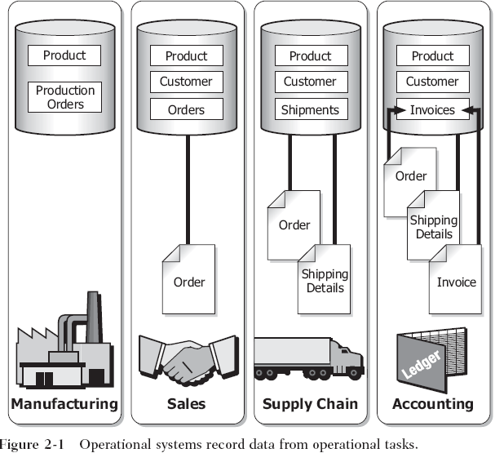
OLTP Databases

Slide 18
Data Warehousing
Data Warehousing is a repository providing access to integrated enterprise-wide data for management and decision support analysts.(Denormalized DB)
The information is subject-orientated, recorded over time and may be stored at various degrees of summarization (Granularity)
Solves the problem of having multiple Data sources and “integrates” the data

Slide 19
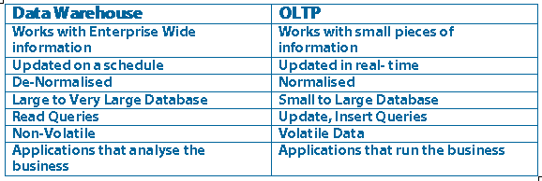
Data Warehouse(OLAP) And OLTP
Notes:
OLTP Table normalised to Third Form
Contains entities, attributes, keys (primary, foreign etc), relationships
DW
Controlled redundancy – aids query response times

Slide 20
Why OLAP?
Slow-to-execute queries
General system slowdowns(Locking)
Manual query writing
Disparate data sources
Data is not available to all users

Slide 21
OLAP Dimensional Modeling
Dimensional modeling is the design concept used by many data warehouse designers to build their data warehouse especially when BI is being planned
Dimensional Modeling is based on the star schema with a centralized fact table surrounded by smaller dimensional tables representing key scientific objects

Slide 22
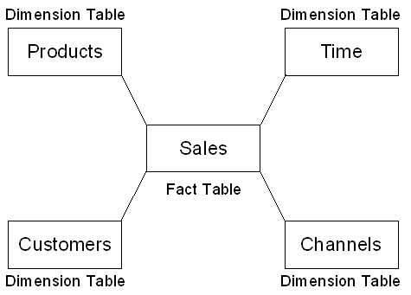
Star Schema Explained
      Dimension table: It is a business entity of the source system.
      Example: Time Dimension, Customer Dimension, Product Dimension
      Fact table: A central table containing numerical measures and keys relating facts to dimension tables
      Example: Profitability
      “What is a measure?”

Slide 23
Implementation of BI
Data Source
Data Integration
Data Storage
Data Analysis
Data Presentation
Meta data, Security, Performance & Operations

Slide 24
Data Analysis
  Enables the creation of Unified Dimensional Model (UDM) over one or more physical data sources
  Automatically aggregates the Data producing summary values calculated during cube processing.
  Aggregations allow SSAS to ready calculations before queries are executed, thereby dramatically improving application response times. Even if you have millions of transactions stored in your database, SSAS can generate a summary report of these transactions within a second.

Slide 25
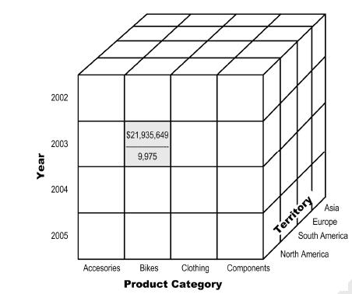
What is Cube?
Measures
Dimensions
Aggregations

Slide 26
Data Analysis
How does SSAS Store this Data?
MOLAP
  records both data and summary values in Analysis Services proprietary file format (Most Efficient) At the end it is an object class
ROLAP
  records both data and aggregations in a relational database.
HOLAP
  stores data in a relational database while aggregations are stored in multidimensional format.

Slide 27
What’s Next?
Data Mining
The process of analyzing data to identify patterns or relationships
  Searching large volumes of data looking for patterns that accurately predict behavior in customers and prospects
  Helps in predicting what future data may look like based on historical database

Slide 28
Implementation of BI
Data Source
Data Integration
Data Storage
Data Analysis
Data Presentation
Meta data, Security, Performance & Operations

Slide 29
Data Presentation
  Using Excel pivot tables and more
  Using SQL Server Reporting Services (SSRS)
  Understanding SharePoint 2003/2007 Web parts
  Reporting tools (Crystal Reports)
  3rd Party tools (ProClarity)

Slide 30
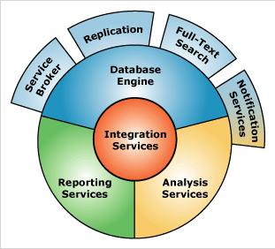
SQLServer 2008 Solution
The Database Engine is the core service for storing, processing, and securing data.
Analysis Services is the core service for supporting rapid analysis of business data, delivering online analytical processing (OLAP) and data mining functionality in business intelligence applications
Integration Services is a platform for building enterprise-level data integration and data transformations solutions.
Replication is a set of technologies for copying and distributing data and database objects from one database to another, and then synchronizing between the databases.

Slide 31
SQLServer 2008 Solution
SSRS is a server-based reporting platform that provides comprehensive data reporting from relational and multidimensional data sources
Notification Services is a platform for developing applications that generate and send notifications, and it is also an engine that runs those applications.
SQL Server contains the functionality you need to issue full-text queries against plain character-based data in SQL Server tables.
Service Broker provides the SQL Server Database Engine native support for messaging and queuing applications

